Slide 1


© 2014 Microsoft Corporation. All rights reserved. Microsoft, Windows, and other product names are or may be registered trademarks and/or trademarks in the U.S. and/or other countries.
The information herein is for informational purposes only and represents the current view of Microsoft Corporation as of the date of this presentation. Because Microsoft must respond to changing market conditions, it should not be interpreted to be a commitment on the part of Microsoft, and Microsoft cannot guarantee the accuracy of any information provided after the date of this presentation. MICROSOFT MAKES NO WARRANTIES, EXPRESS, IMPLIED OR STATUTORY, AS TO THE INFORMATION IN THIS PRESENTATION.

Slide 2

Microsoft
DevCamp
Scaling from the small screen to the big screen

Slide 3
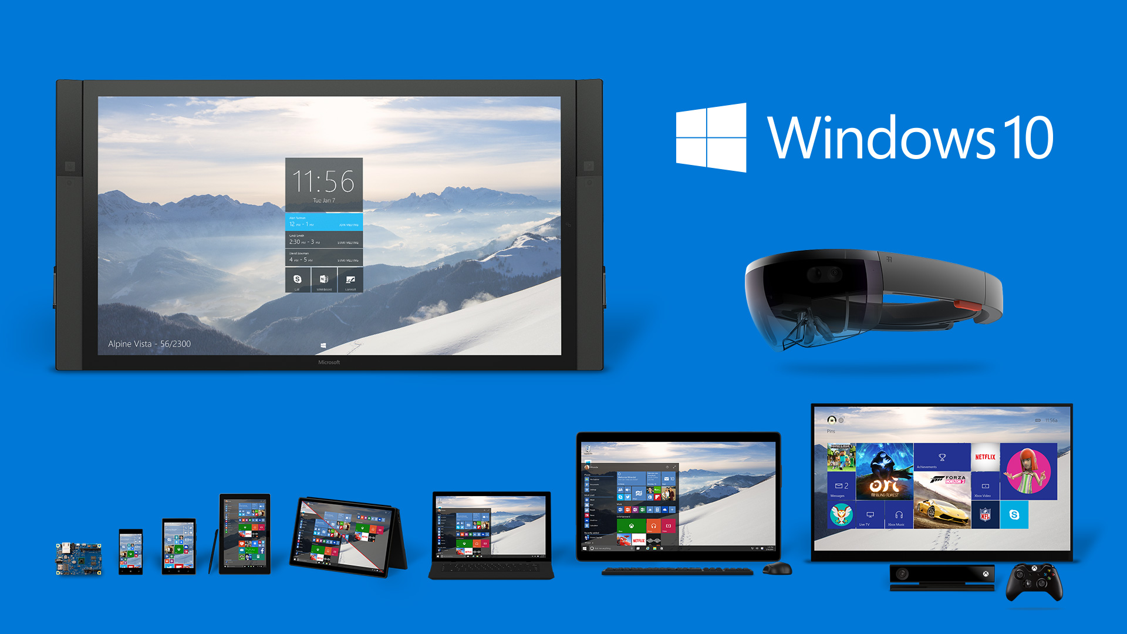

Slide 4
Device considerations for your app
Screen size
Hardware capabilities/tech
Connectivity
Primary input
Personal vs. shared
Environment
Duration of use

Slide 5
Effective Pixel Scaling

Slide 6
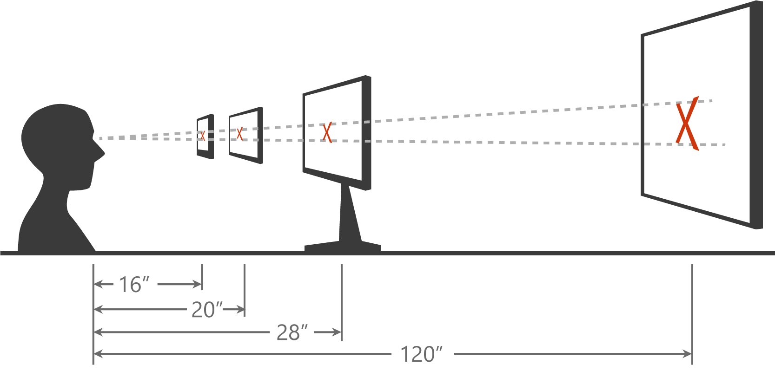
Scaling algorithm
Takes viewing distance and pixel density into account to optimize for perceived size rather than physical size

Slide 7
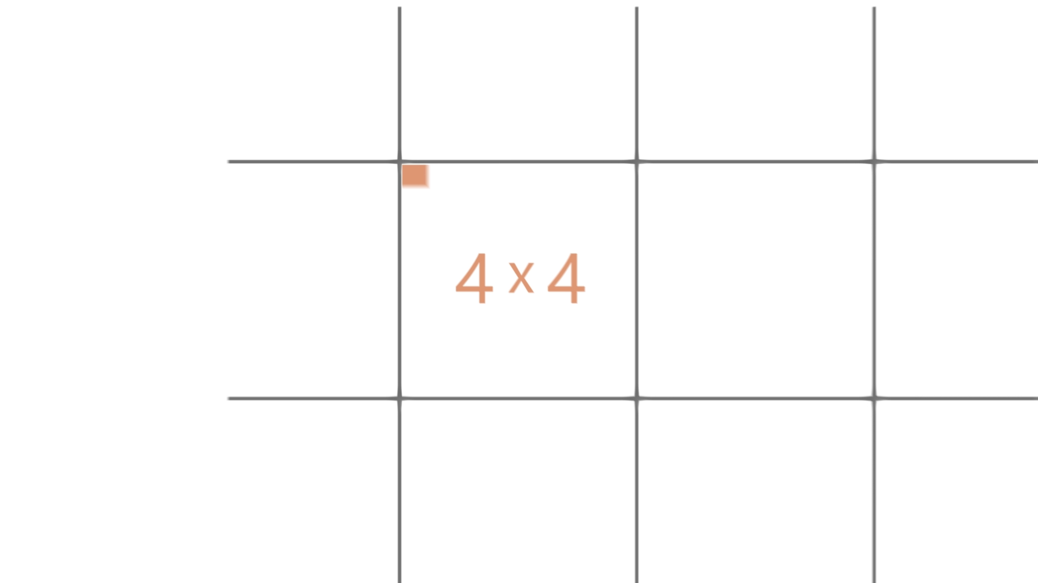

Slide 8
Support for Automatic Scaling
Scale Factors | 100 | 125 | 150 | 200 | 250 | 300 | 400
Single scale factor system for all apps
Guarantees consistent visual size of text and graphics (abstracts panel density and viewing distance for you)
100%, 200% and 400% are the most important sizes to support in assets
Scale factors work well with 4-px grid

Slide 9
Dynamic Layout

Slide 10
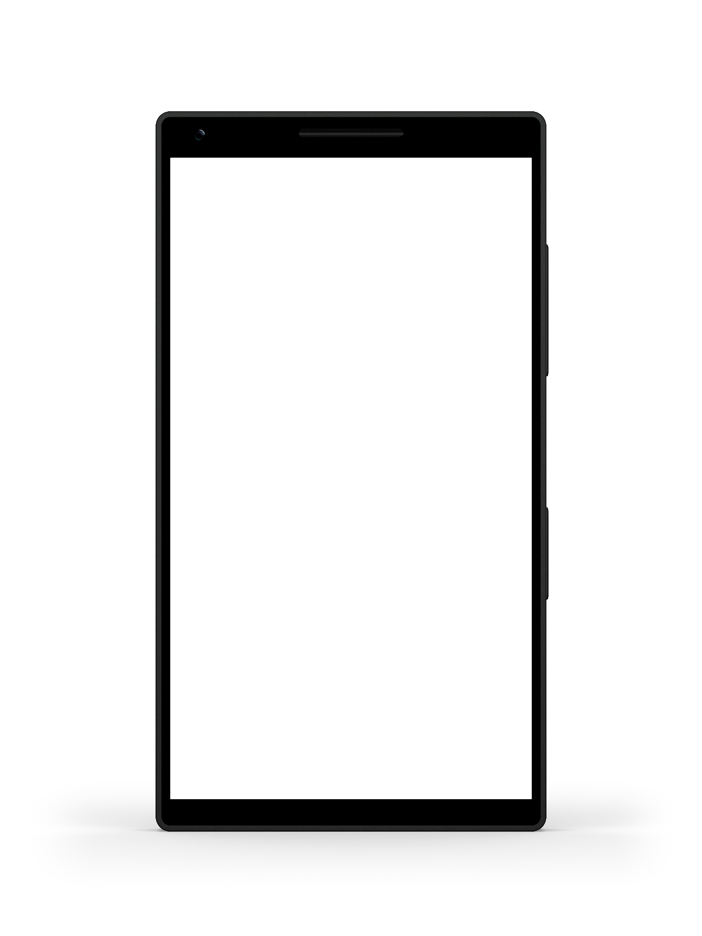
Breakpoints
320epx

Slide 11
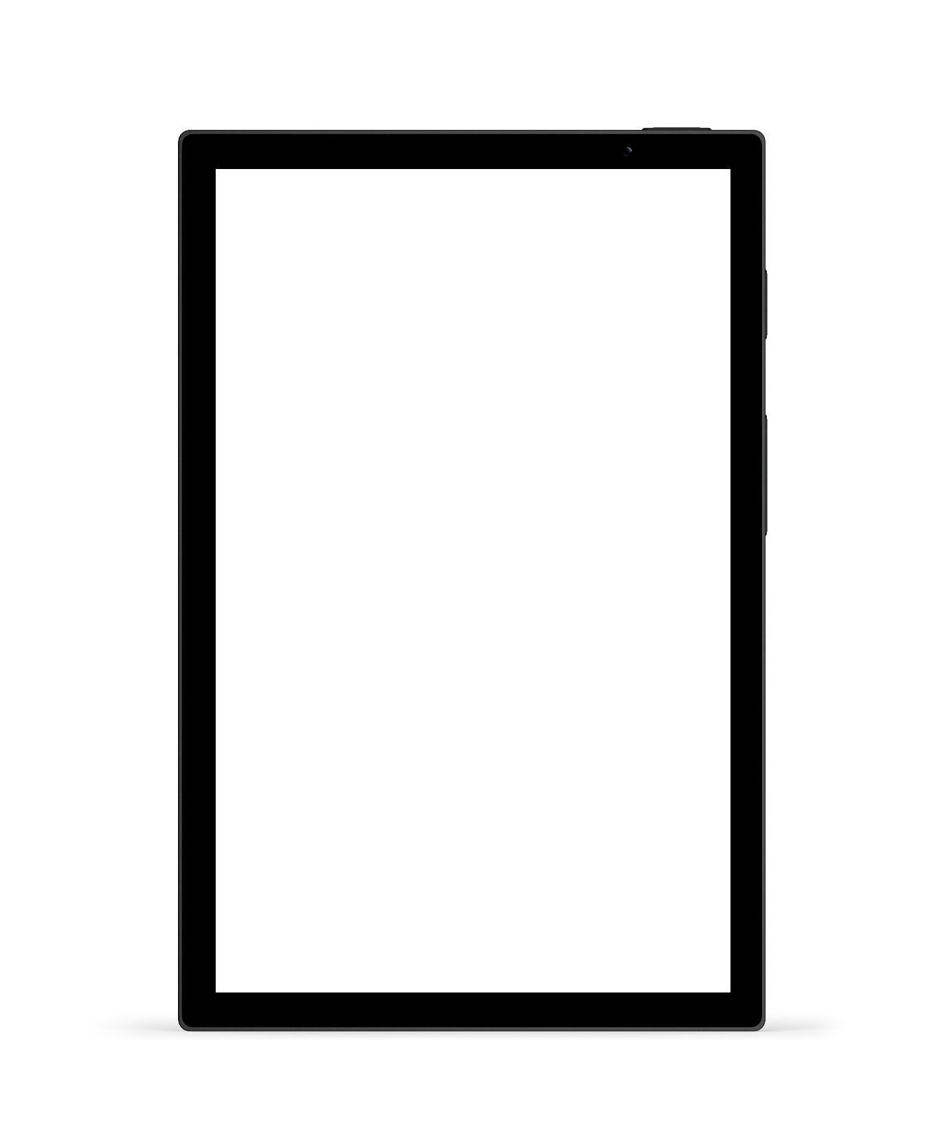
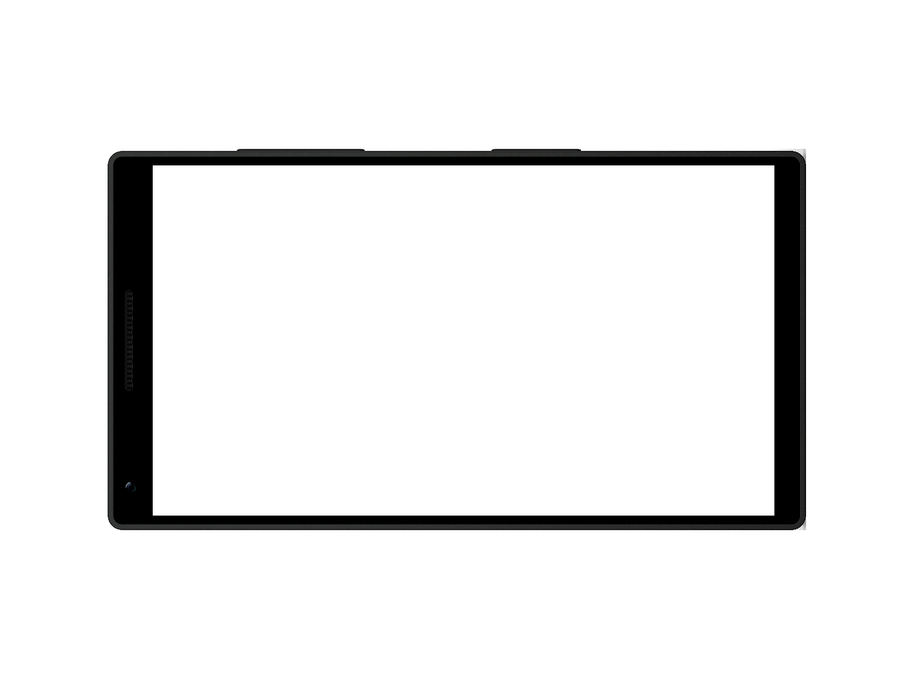
Breakpoints
720epx
720epx

Slide 12
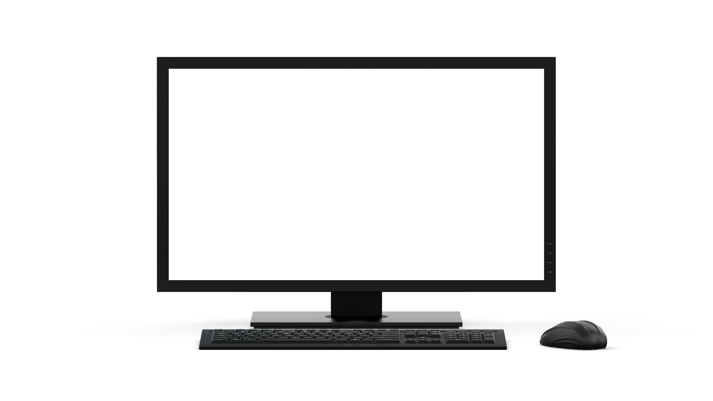
Breakpoints
1024epx

Slide 13
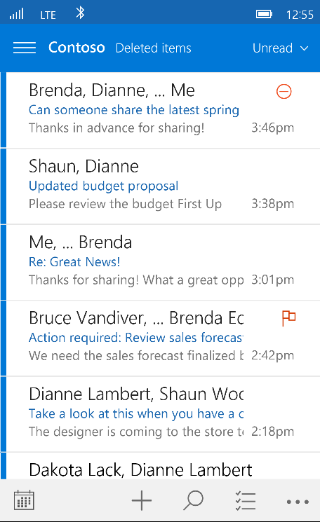
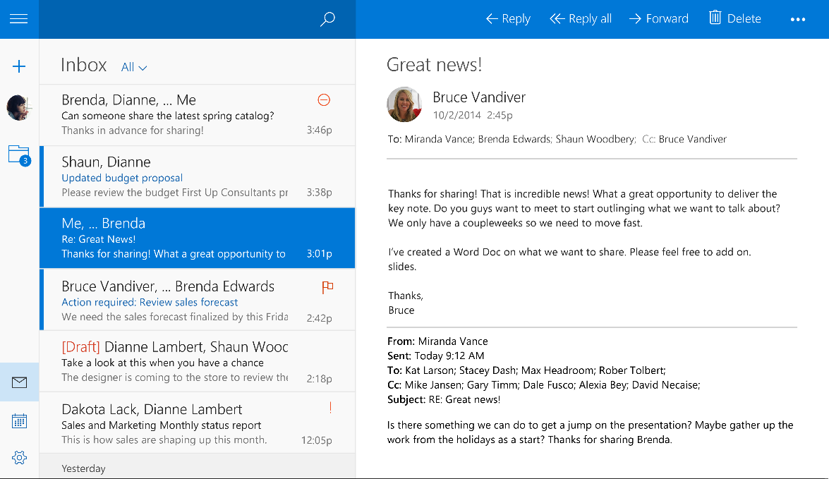
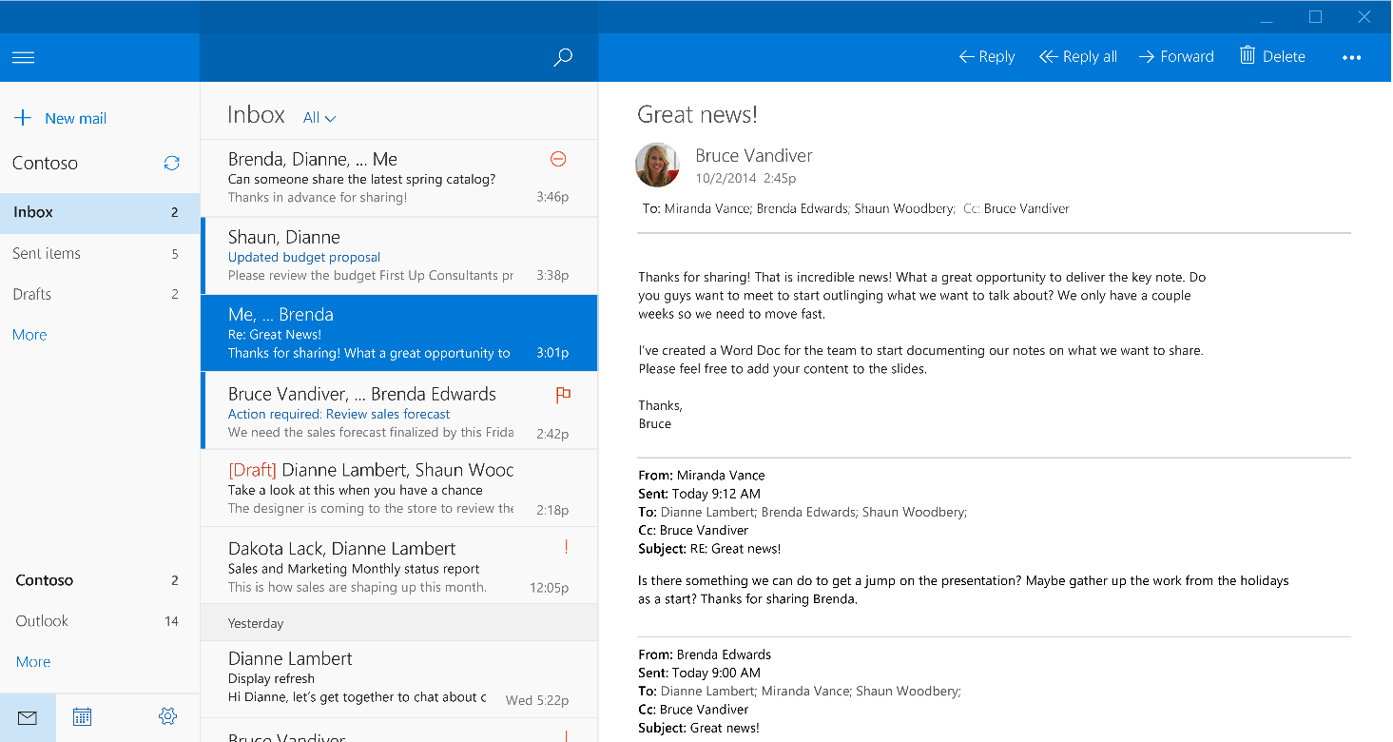
Example: Mail app

Slide 14
Visual States and Action Triggers

Slide 15
Visual State Triggers (code snippet)
<VisualStateGroup x:Name="WindowSizeStates">
<VisualState x:Name="WideState">
<VisualState.StateTriggers>
<AdaptiveTrigger MinWindowWidth="720" />
</VisualState.StateTriggers>
<VisualState.Setters>
<Setter Target="MySplitView.IsPaneOpen" Value="True" />
<Setter Target="MySplitView.DisplayMode" Value="Inline" />
</VisualState.Setters>
</VisualState>
</VisualStateGroup>

Slide 16
VisualState Triggers
“media queries” for XAML
Respond to a condition and goes to that state
Declarative way of doing what you can today
Built-in AdaptiveTrigger for window size
Setters enable more readable/direct value changing

Slide 17
RelativePanel Control

Slide 18
RelativePanel
Constraint-based panel
Allows developers to express spatial relationships
Huge enabler for responsive UI scenarios
Leverage’s x:Name’d elements for RelativeTo* positioning

Slide 19
RelativePanel (code snippet)
<RelativePanel x:Name="panel" Margin="4.75" Height="190">
<Image x:Name="MapImage" controls:GoogleImageDependencyObject.GoogleImageUrl="{Binding Map}" Stretch="None“ RelativePanel.AlignBottomWithPanel="True" RelativePanel.AlignLeftWithPanel="True" RelativePanel.AlignRightWithPanel="True" RelativePanel.AlignTopWithPanel="True" HorizontalAlignment="Stretch" VerticalAlignment="Stretch"/>
<Rectangle x:Name="topRect" Fill="White" Opacity="0.85" Height="30“ RelativePanel.AlignBottomWithPanel="True“ RelativePanel.AlignLeftWithPanel="True" RelativePanel.AlignRightWithPanel="True" HorizontalAlignment="Stretch"/>
<Rectangle x:Name="bottomRect" Fill="White" Opacity="0.85" Height="45“ RelativePanel.AlignTopWithPanel="True“ RelativePanel.AlignLeftWithPanel="True" RelativePanel.AlignRightWithPanel="True" HorizontalAlignment="Stretch"/>
<Image Source="{Binding TypeImageUrl}" Height="18" Margin="4.75“ RelativePanel.AlignBottomWithPanel="True“ RelativePanel.AlignLeftWithPanel="True"/>
<Image Source="ms-appx:///Assets/ThumbsUp.png" Height="18" Margin="4.75" RelativePanel.AlignBottomWithPanel="True" RelativePanel.AlignHorizontalCenterWithPanel="True"/>
<Image Source="ms-appx:///Assets/appbar.trophy.png" Height="18" Margin="4.75" RelativePanel.AlignBottomWithPanel="True" RelativePanel.AlignRightWithPanel="True"/>
<Ellipse x:Name="profilePic" Style="{StaticResource ProfileEllipse}" Margin="4.75“ RelativePanel.AlignLeftWithPanel="True" RelativePanel.AlignTopWithPanel="True">
…
</Ellipse>
<TextBlock x:Name="ActivityName" Text="{Binding Name}" TextTrimming="CharacterEllipsis" Foreground="{StaticResource KlivaMainBrush}" Margin="0,0,4.75,0" FontFamily="{StaticResource OpenSansFontSemibold}“ RelativePanel.AlignTopWithPanel="True" RelativePanel.RightOf="profilePic"/>
<TextBlock x:Name="ActivityMetaData" Text="{Binding Athlete.FullName}" RequestedTheme="Light" Margin="0,-2.375,4.75,0“ FontFamily="{StaticResource OpenSansFontLight}“ RelativePanel.RightOf="profilePic" RelativePanel.Below="ActivityName"/>
<TextBlock x:Name="ActivityDateTime" Text="{Binding StartDate, Converter={StaticResource RelativeTimeConverter}}" FontFamily="{StaticResource OpenSansFontSemibold}" Foreground="DarkGray" Margin="4.75,-2.375,4.75,0" />
</RelativePanel>

Slide 20
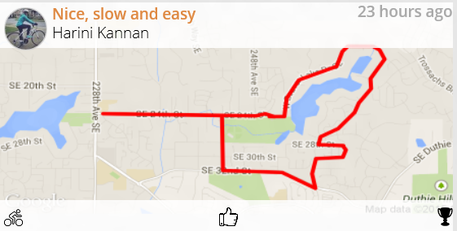
RelativePanel Spatial Properties
Above
Below
LeftOf
RightOf
Align*With
Top, Bottom, Left, Right, HorizontalCenter, VerticalCenter

Slide 21
SplitView Control (Hamburger Menu)

Slide 22
SplitView Control
Building block for transient content
Can be used for navigational patterns
Helps with responsive UI scenarios for showing related UI in single views
No direct guidance built-in – use it if it makes sense
Overlay, Inline and Compact modes

Slide 23
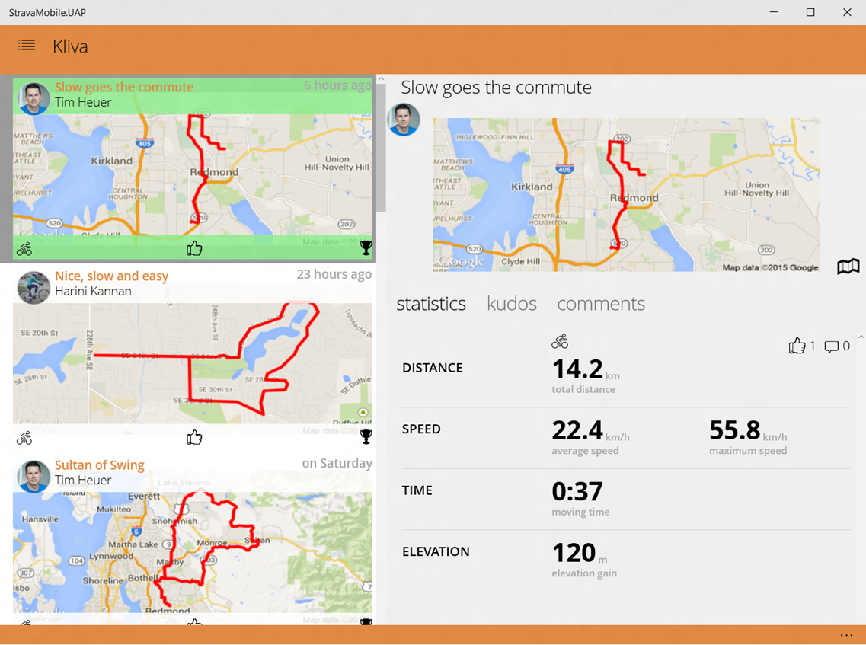
SplitView
Pane
Content

Slide 24
Commandbar

Slide 25
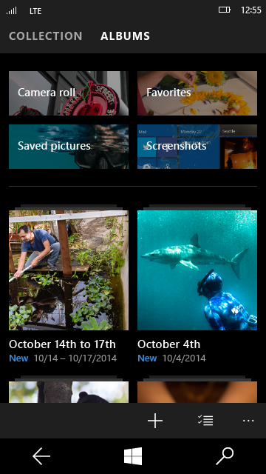
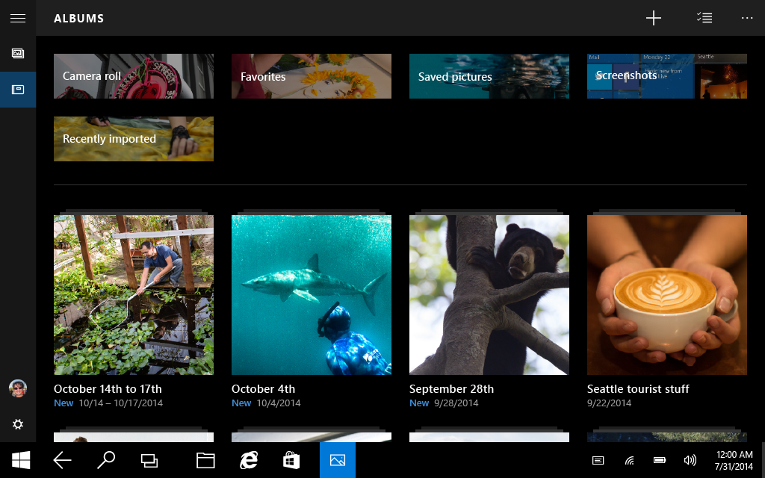

commandBar

Slide 26
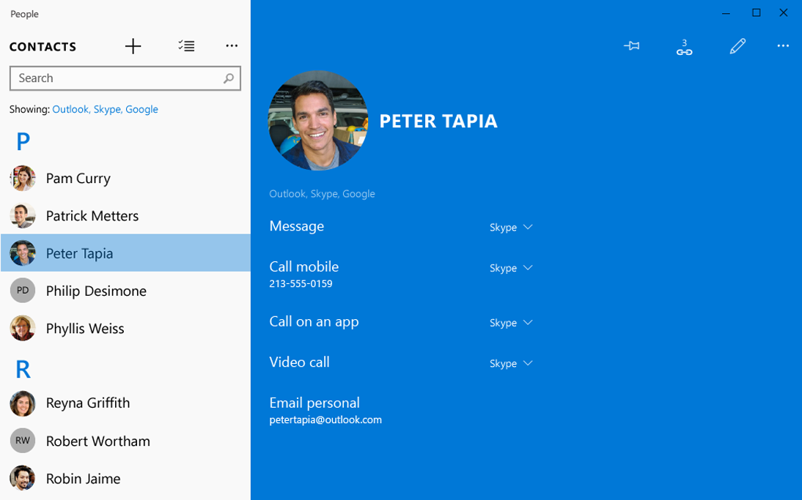
commandBar: placement

Slide 27
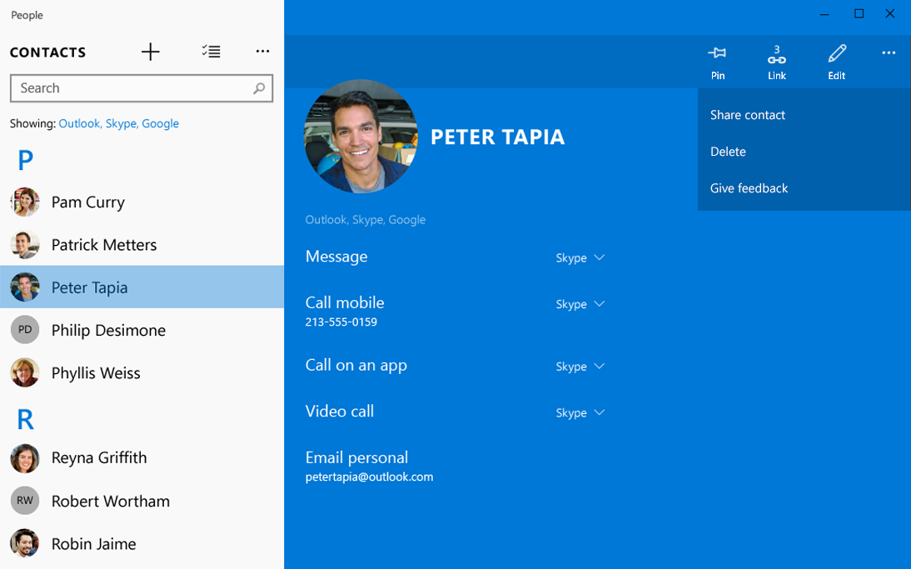
commandBar

Slide 28
UI Patterns

Slide 29
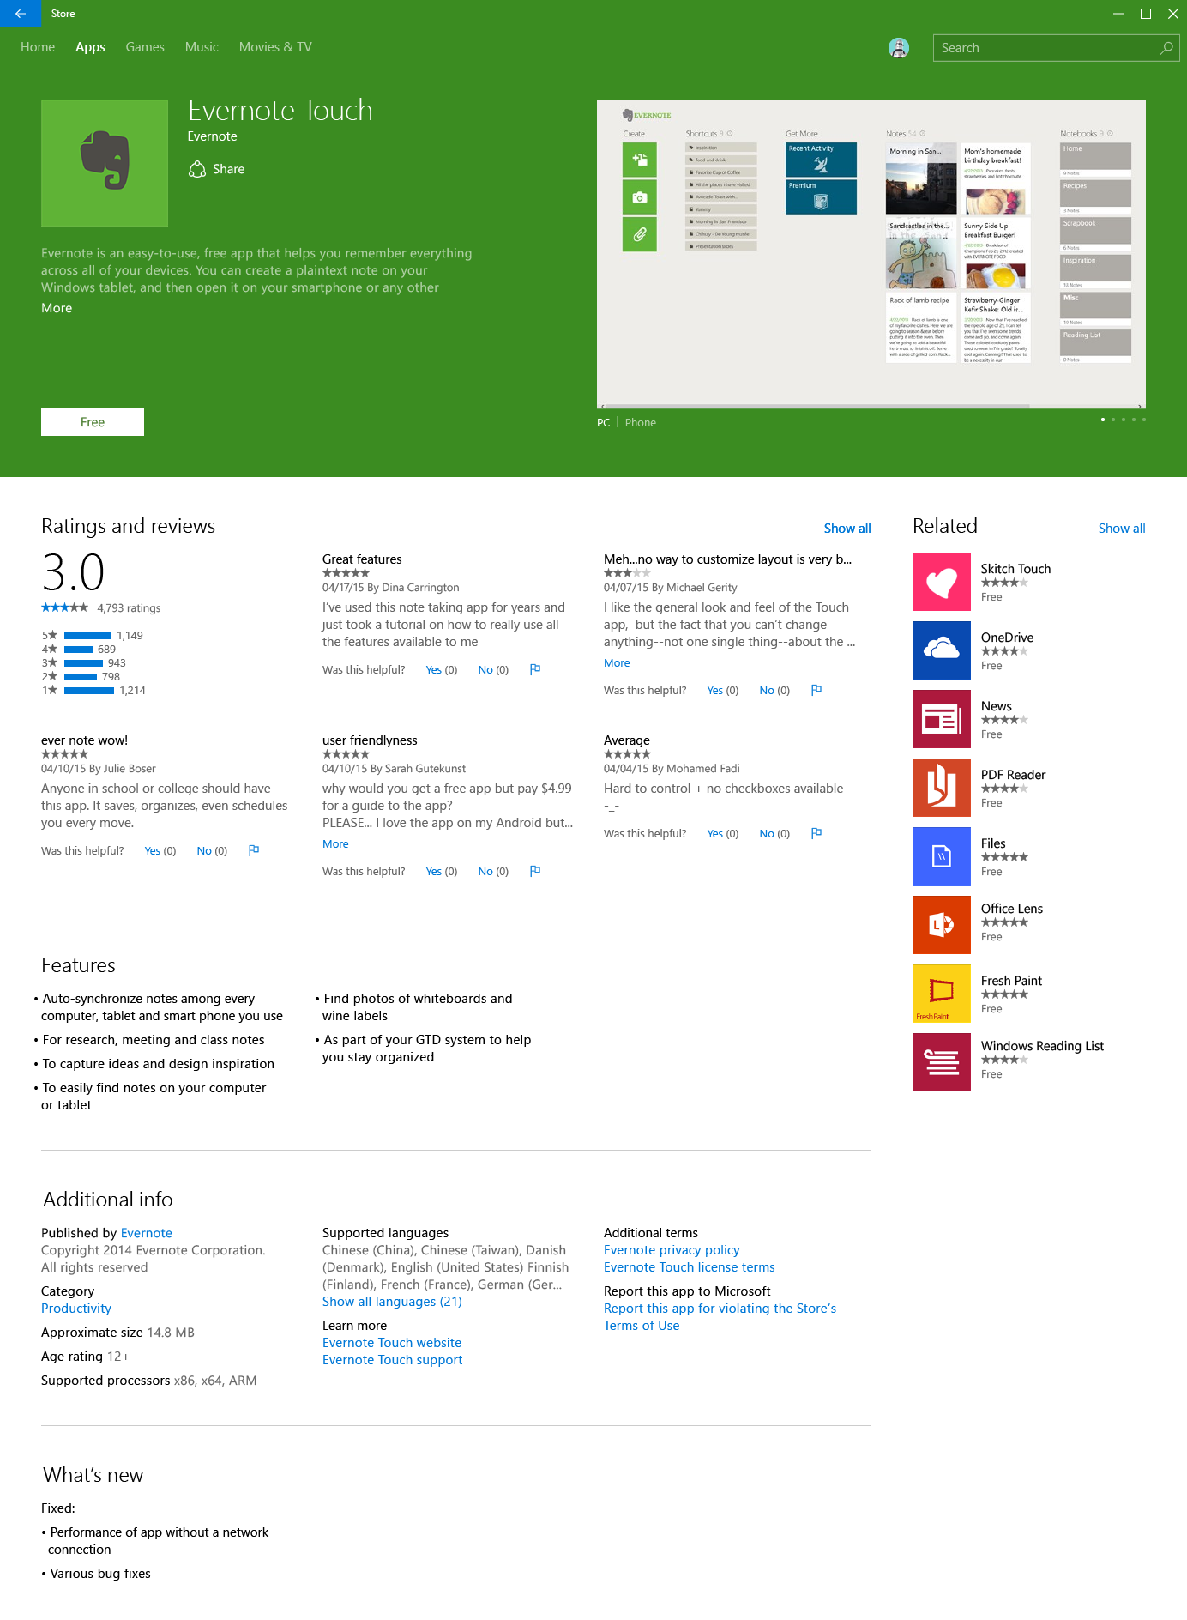
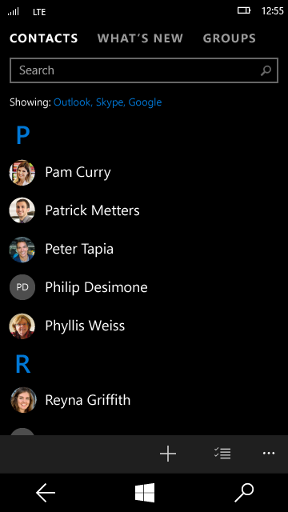
Pivots

Slide 30
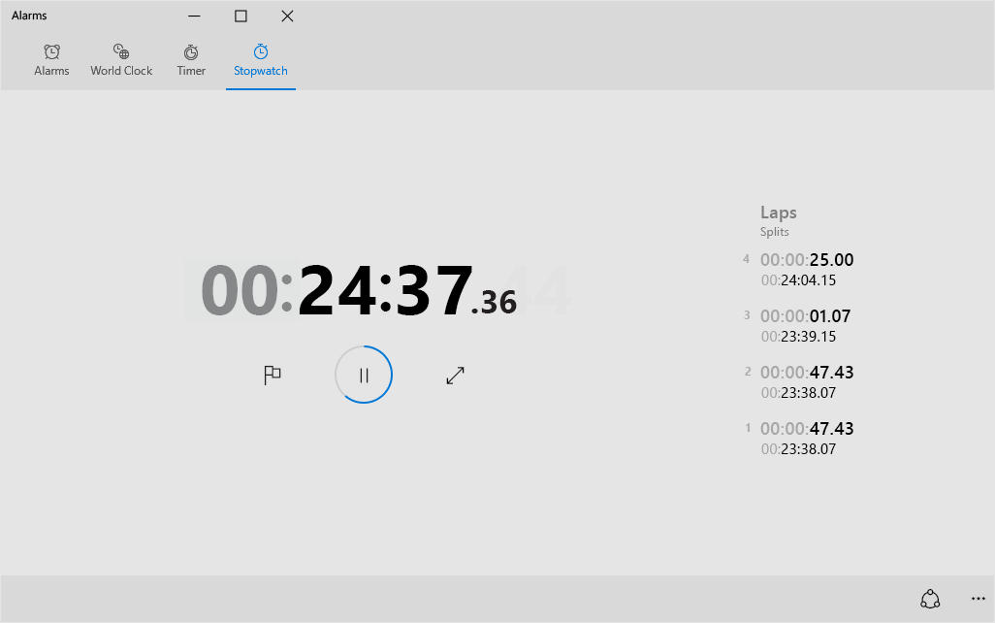
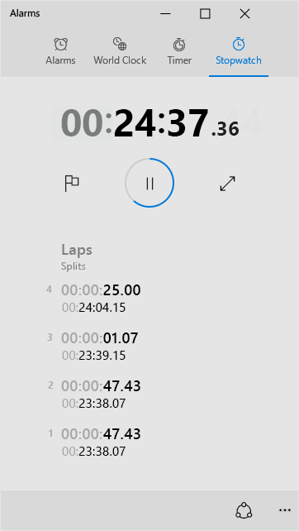
Tabs

Slide 31
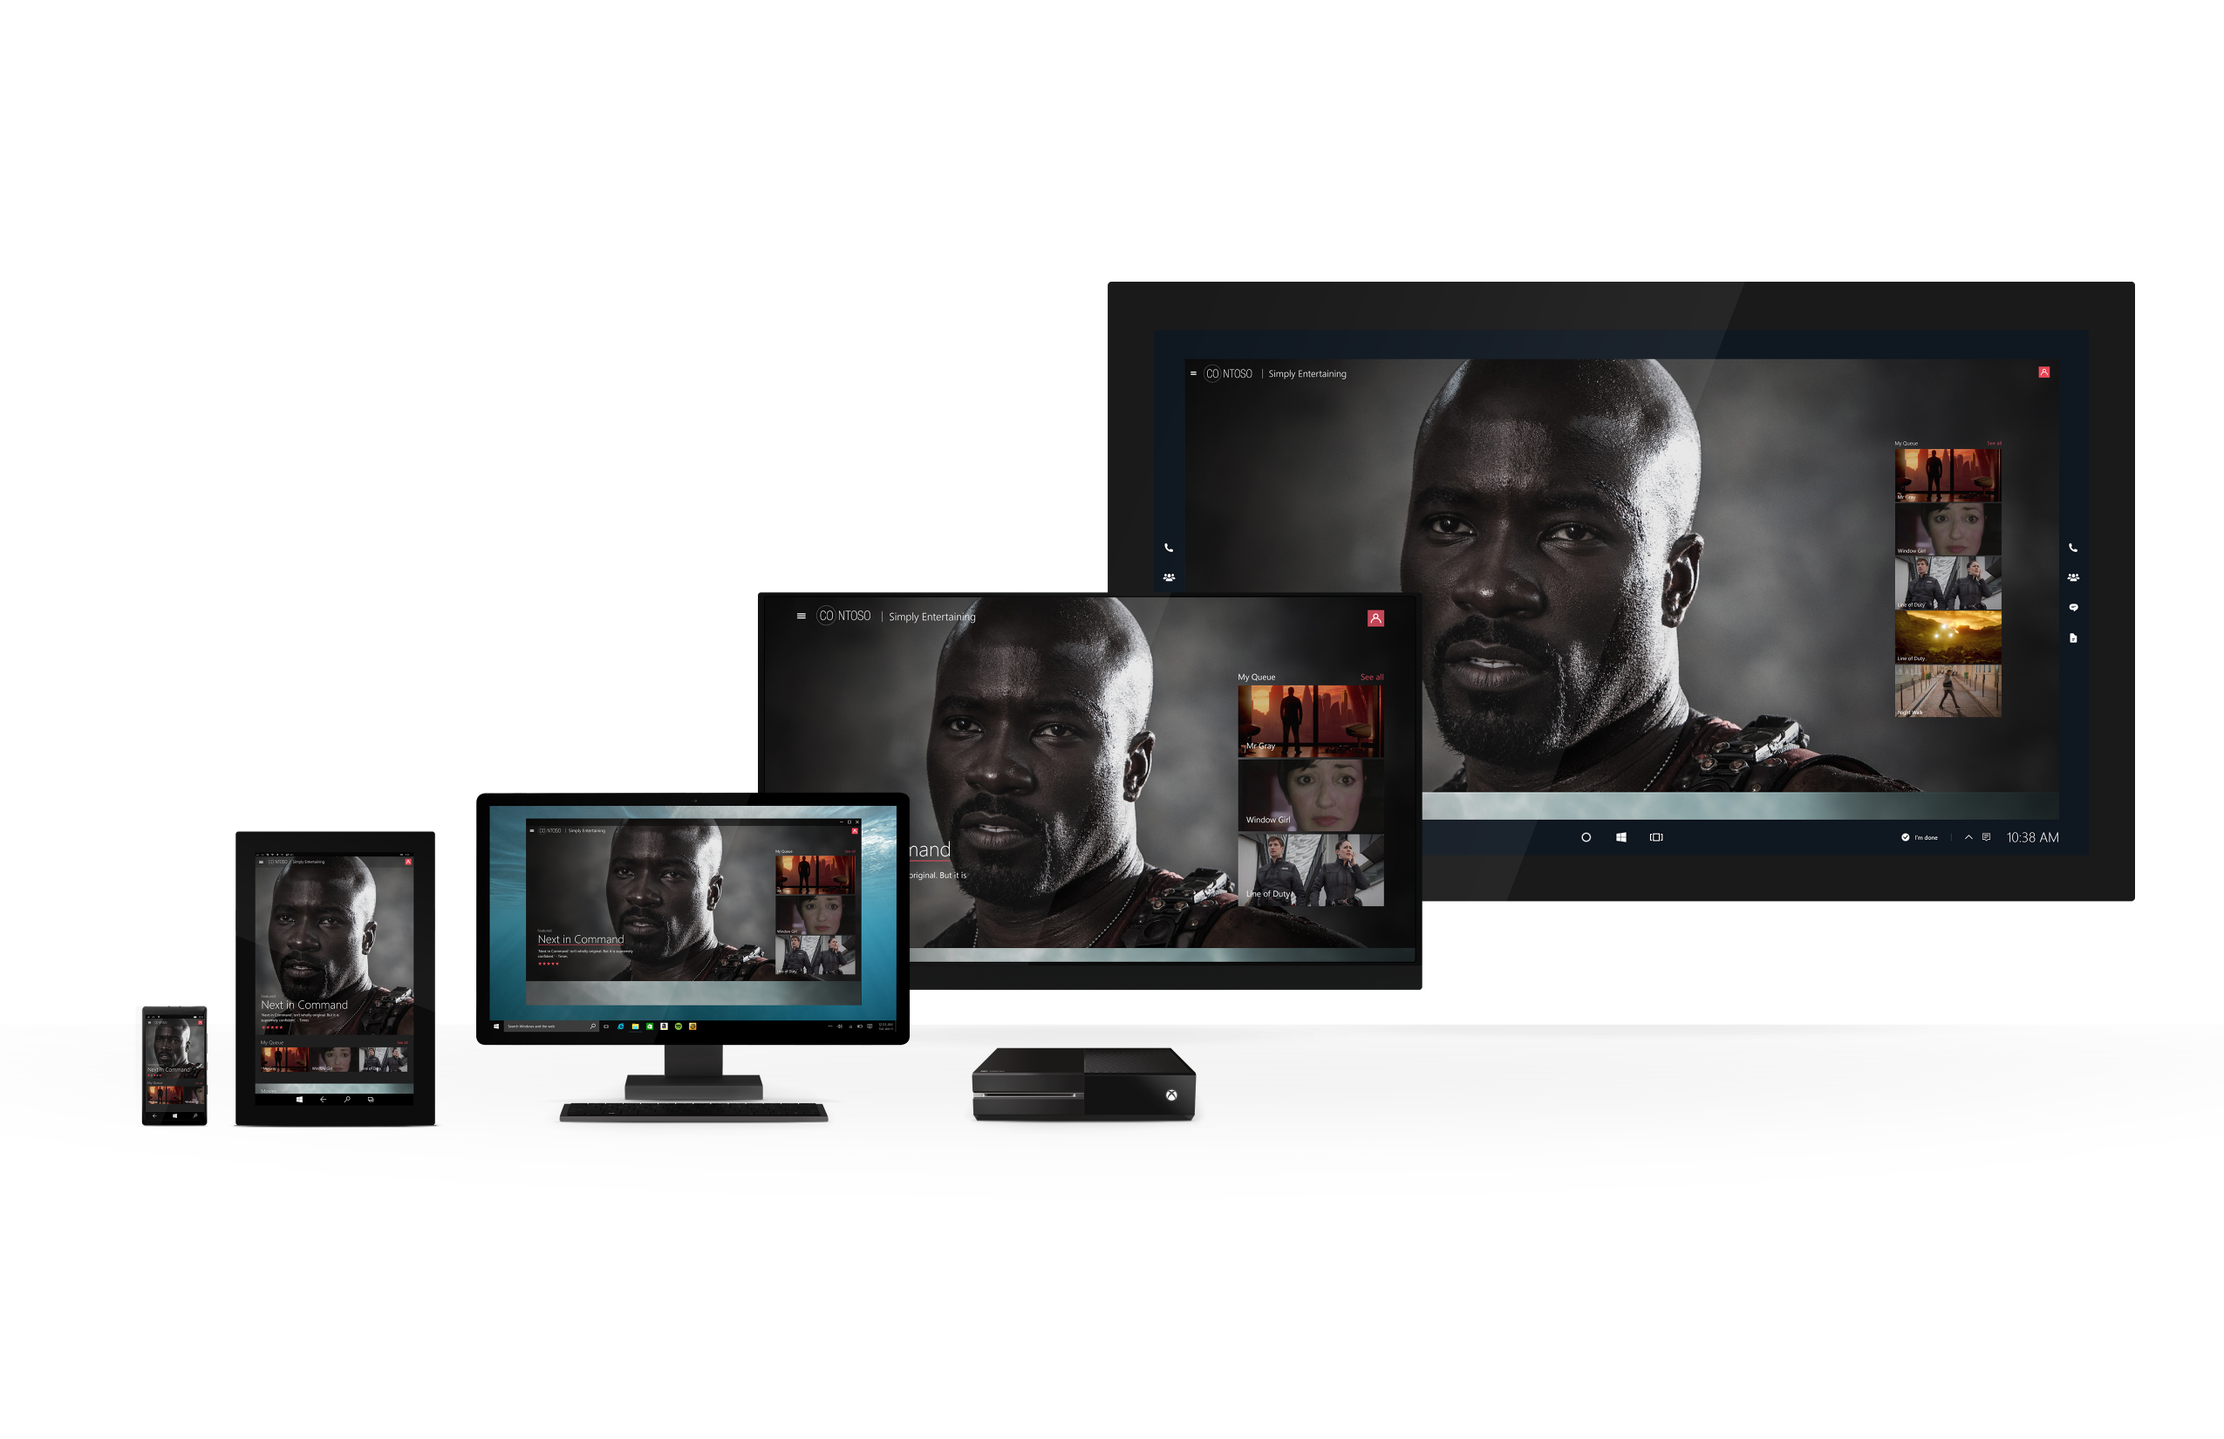
Hub

Slide 32
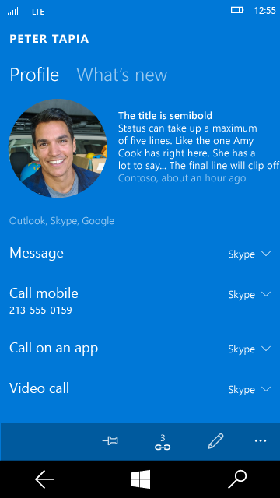
Master-Detail

Slide 33
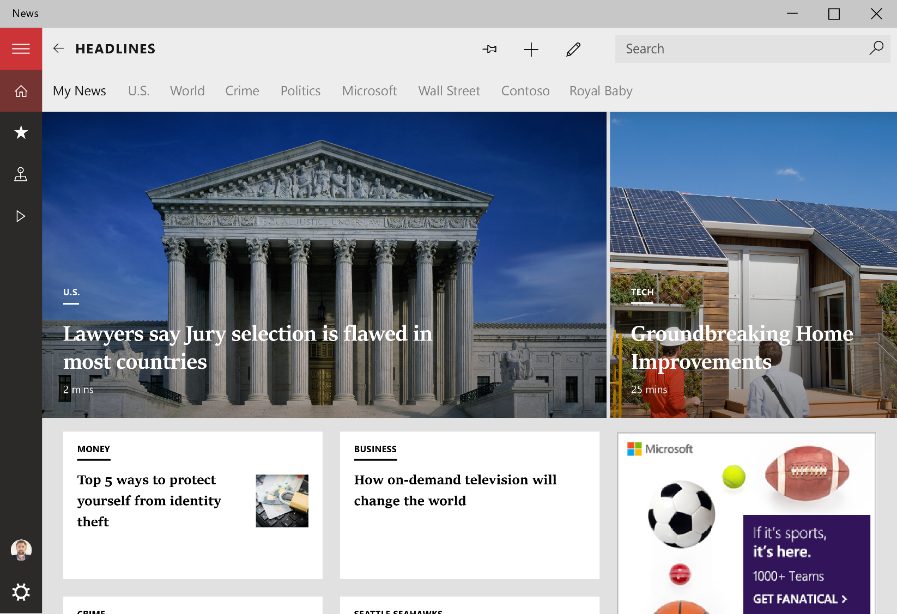
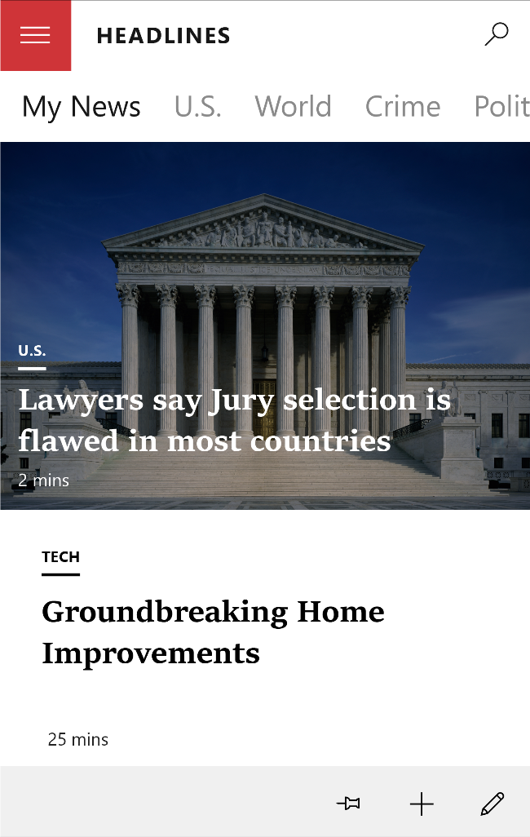
Hamburger

Slide 34

Hamburger

Slide 35
Dynamic Layout Strategies

Slide 36
The 6 R’s
Resize
Reflow
Reposition
Reveal
Re-architect
Replace

Slide 37
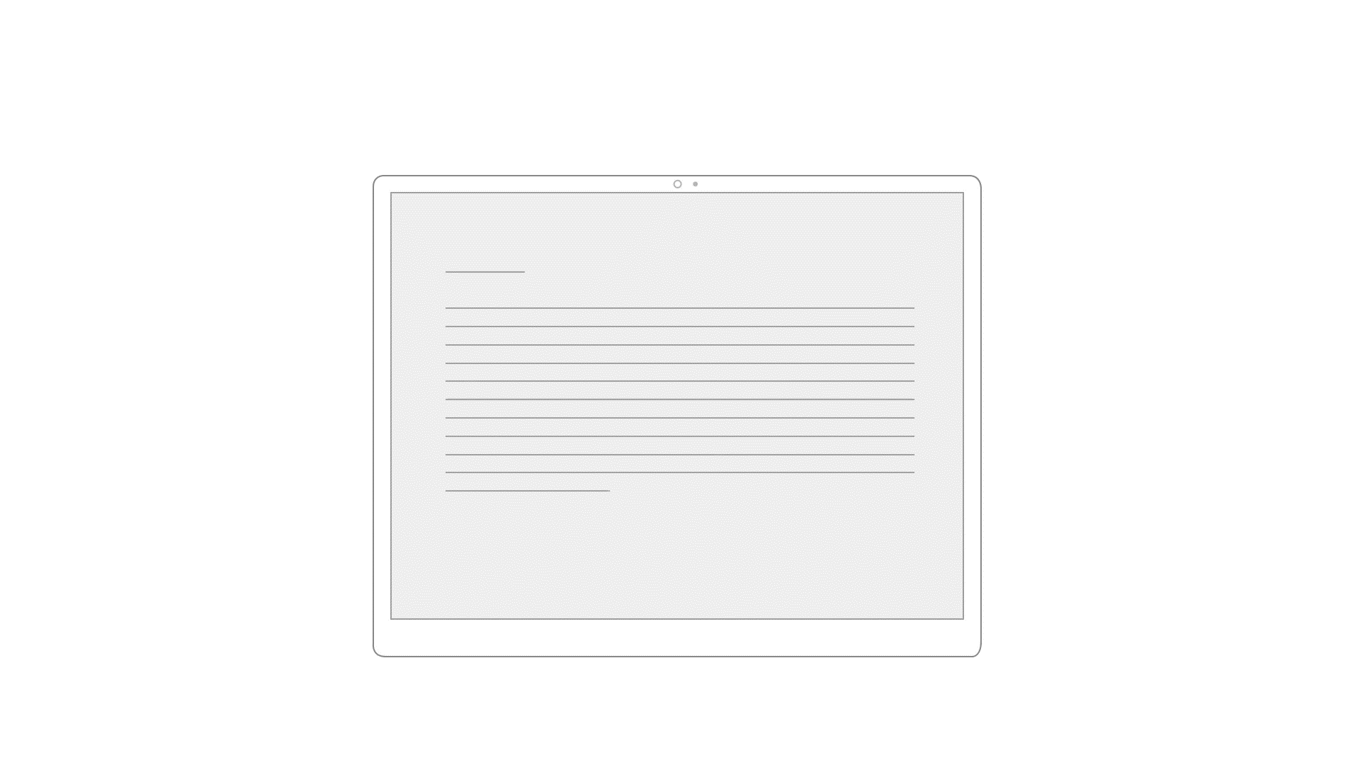
1. Resize

Slide 38
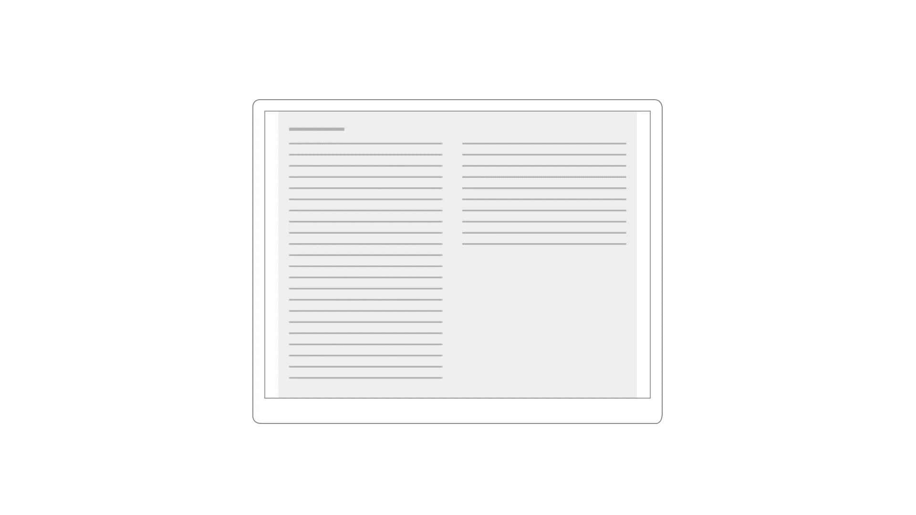
2. Reflow

Slide 39
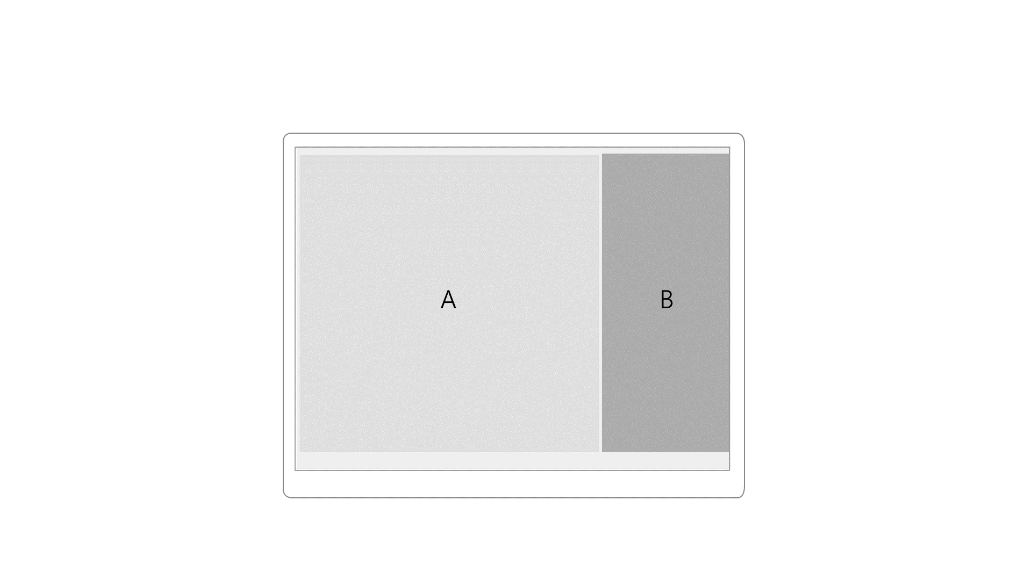
3. Reposition

Slide 40
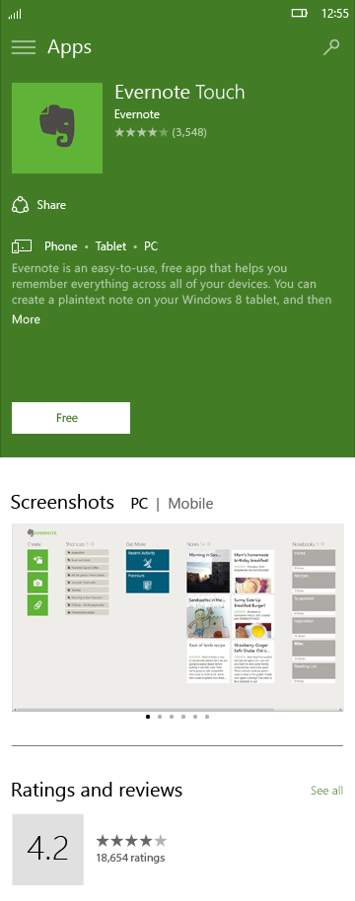
3. Reposition

Slide 41
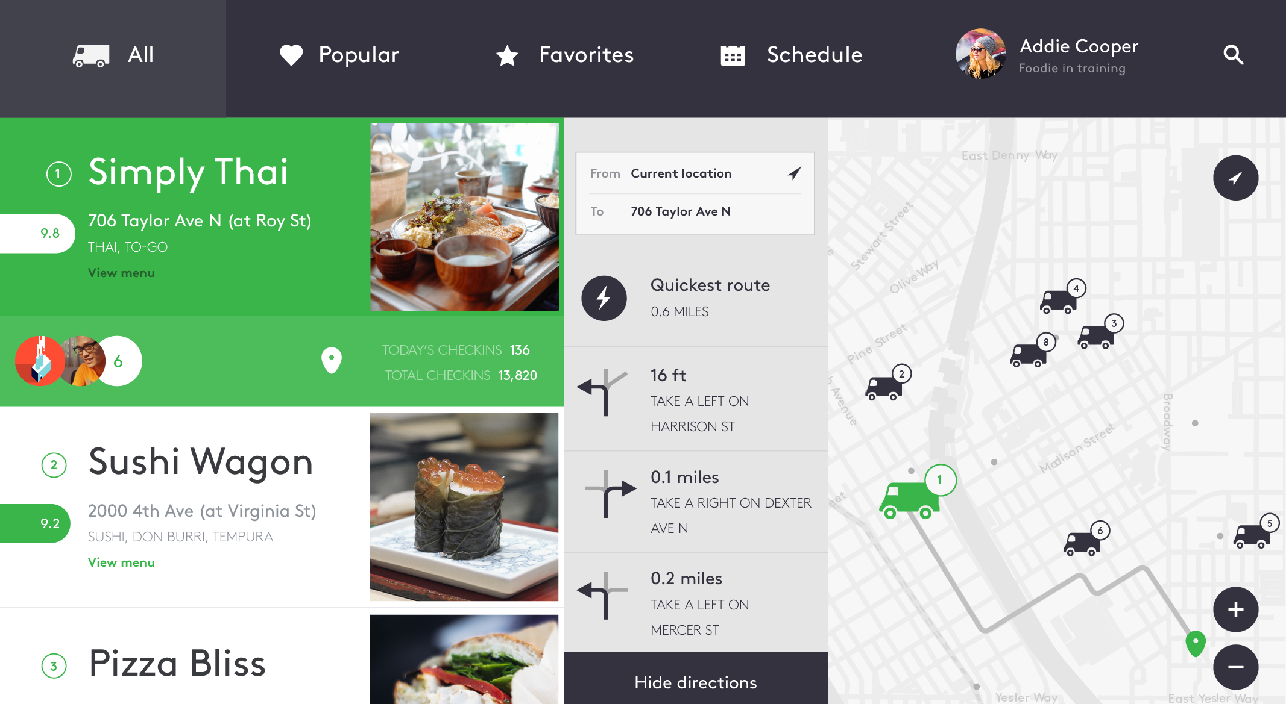
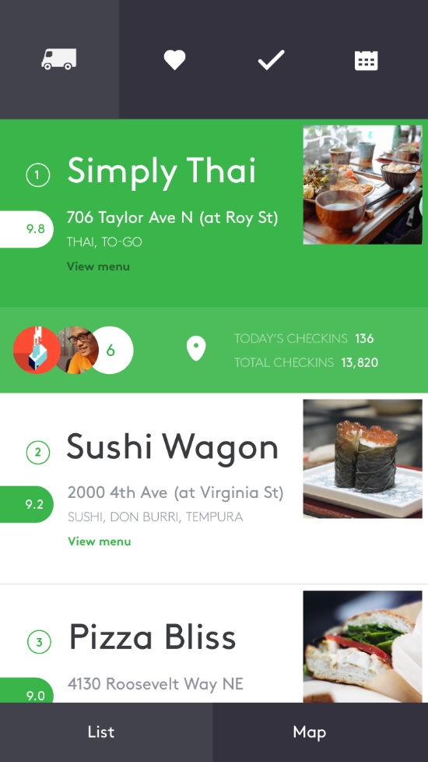
4. Reveal

Slide 42
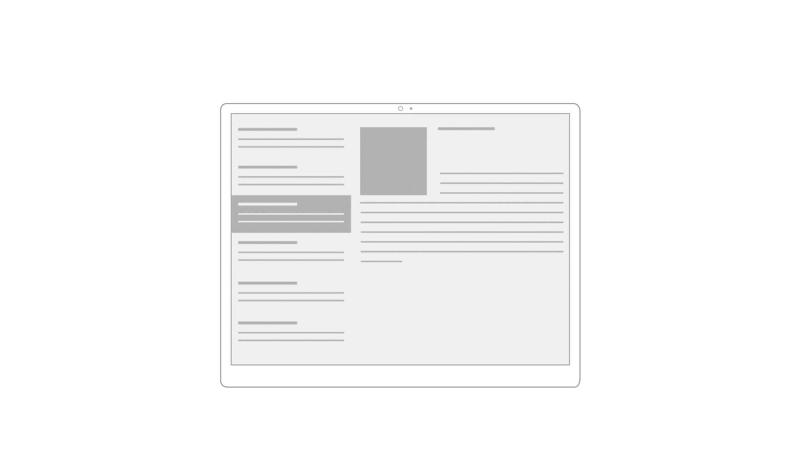
5. Re-architect

Slide 43
5. Re-architect

Slide 44
6. Replace

